Slide 1
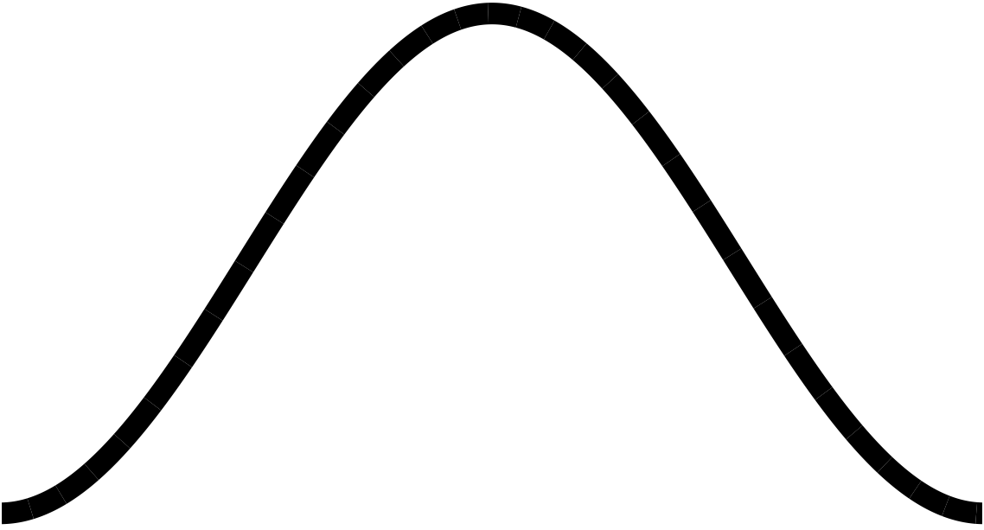
Phase vocoder, part 3
Learn
Modifying signals in frequency domain
Converting frequency to phase
Analysis and synthesis windows
Bring everything together to create phase vocoder effects:
Robotisation (phase zeroing)
Whisperisation (phase randomisation)
Pitch shifting
FFT
effect
IFFT

Slide 2
The full signal chain
Block 0
Block 1
Block 2
x[n]
S0
S1
S2
S3
S4
S5
S6
S7
S8
S9
S10
S11
S12
S13
S14
S15
S16
S17
S18
S19
S20
S21
S22
S23
...
write
pointer
this happens once per hop (every H samples)
most
recent W
samples
add
result
input
buffer
Apply
window
Block-based
processing
output
buffer
at write
pointer
these processes
happen every frame
read pointer
S0
S1
S4
S5
S6
S7
S8
S9
S12
S13
S14
S15
S16
S17
S20
S21
S22
S2
S23
S3
S10
S11
S18
S19
y[n]
...

Slide 3
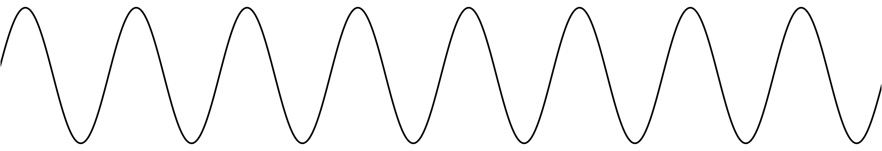
Robotisation
Simple phase vocoder effect to generate robot-like voices
At each hop, set phase of every bin to 0
But preserve magnitude of bin, preserving the shape of the spectrum
What does zeroing the phase do?
No phase change between hops
That means that hops always advance by an integer number of cycles
Thus the period of every bin must be an integer division of the hop size and the frequency of each bin must be a multiple of the the hop frequency fs/H
So the robotisation effect imposes a constant pitch determined by the hop size
...
y[n]

Slide 4
Review of signal chain
Block 0
Block 1
Block 2
x[n]
S0
S1
S2
S3
S4
S5
S6
S7
S8
S9
S10
S11
S12
S13
S14
S15
S16
S17
S18
S19
S20
S21
S22
S23
...
write
pointer
possible problem:
discontinuity at block edges
most
recent W
samples
add
result
input
buffer
Apply
window
Block-based
processing
output
buffer
at write
pointer
read pointer
S0
S1
S4
S5
S6
S7
S8
S9
S12
S13
S14
S15
S16
S17
S20
S21
S22
S2
S23
S3
S10
S11
S18
S19
y[n]
...
ECS7012P Music and Audio Programming • Week 11a

Slide 5
Analysis and synthesis windows
Block 0
Block 1
Block 2
x[n]
S0
S1
S2
S3
S4
S5
S6
S7
S8
S9
S10
S11
S12
S13
S14
S15
S16
S17
S18
S19
S20
S21
S22
S23
...
write
pointer
Apply window function again after frequency-domain processing
Same length as analysis window, but could be different type
most
recent W
samples
add
result
input
buffer
Apply
window
Block-based
processing
Apply
window
output
buffer
at write
pointer
analysis
window
synthesis
window
read pointer
S0
S1
S4
S5
S6
S7
S8
S9
S12
S13
S14
S15
S16
S17
S20
S21
S22
S2
S23
S3
S10
S11
S18
S19
y[n]
...
ECS7012P Music and Audio Programming • Week 11a

Slide 6
Robotisation
For the cleanest effect, we need to apply both analysis and synthesis windows
Analysis window smoothes the edges of each block coming into the effect
However, changing the phase will scramble the shape of the block, so a synthesis window is also needed to smooth the edges again
Task: in project fft-robotisation
Implement a Hann window for analysis and synthesis
You can calculate the window once in setup() and use the same array for analysis and synthesis
Multiply the block by the window in process_fft()
How does the window change the sound?
Next, make the hop size adjustable with the GUI
FFT
zero phase
IFFT
ECS7012P Music and Audio Programming • Week 11a

Slide 7
The COLA criterion
Often, want to exactly reconstruct signal we transformed to frequency domain
works only for some combinations of window function & hop size
Constant Overlap-Add (COLA) criterion:
Means that windows of length W, added together with a given hop size H, sum to a constant
For rectangular windows: H = W, W/2, W/3, W/4, ...
i.e. any integer division of the window size
For Hann, Hamming, Barlett: H = W/2, W/3, W/4, ...
i.e. divisions at most half the window size
Using Hann windows for analysis and synthesis: H = W/3, W/4, ...
Applying the window twice means it is effectively squared

Slide 8
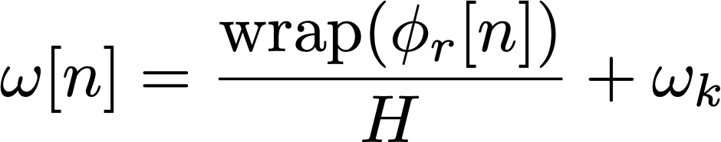
Whisperisation
A simple phase vocoder effect to obscure the pitch of a sound
On speech, it can produce a whisper-like effect
At each hop, randomise the phase of each bin
This means the difference in phase between hops is also randomised
Therefore the frequency of the bins is also randomised (within a certain range)
How much frequency variation can whisperisation introduce?
Phase difference between hops must be in the range ±π
How much difference is that? From earlier:
So the frequency of each bin could differ by up to ±π/H
Smaller hop sizes allow more frequency variation
As with robotisation, analysis and synthesis windows improve the effect
You might also find smaller FFT size produces a more convincing effect

Slide 9
Whisperisation task
Task: in fft-robotisation code, change code to whisperise the sound
In process_fft(), randomise the phase of each bin
Hint: to generate a random float between 0 and 1, use this expression: (float)random() / (float)RAND_MAX
Once you have the magnitude and phase, calculate real and imaginary components
We saw how to do this in Lecture 19
Use cosf_neon() and sinf_neon() for efficiency
Try different settings for window size and hop size

Slide 10
Pitch shifting
When playing audio samples, playback speed and pitch are usually coupled
This is not a digital phenomenon: it’s the same on turntables and audio tapes
How, then, can we change the pitch of a sound without changing its speed?
This cannot be done through filtering because the effect is nonlinear
Linear systems cannot create energy at frequencies that were not present in the input
However, for a pitch shifter, the output signal will have energy at different frequencies than the input signal
Even though we can’t use simple filters, the phase vocoder can help...
read pointer
(play head)

Slide 11
Pitch shifting
We’ve seen that any signal can be represented as the sum of sinusoids
The DFT gives us a snapshot of magnitudes and phases
From phase, we calculated precise frequencies for each bin
Pitch shifting in the frequency domain just involves scaling each frequency
Multiply each frequency by a constant ratio: >1 raises the pitch, <1 lowers the pitch
Then we need to convert frequencies back to magnitudes and phases of each bin
for each hop:
input block
Apply
window
Phase to
frequency
FFT
frequency
ratio
output block
Apply
window
Frequency to phase
IFFT

Slide 12
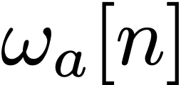

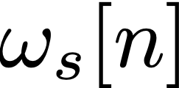
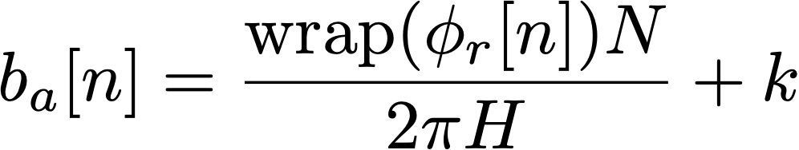


Frequency scaling
Here we will talk about analysis and synthesis frequencies
The analysis frequency is the frequency we calculated from our input signal
The synthesis frequency is a scaled version of it:
Where R is the pitch shift ratio
The notation involving n is to remind us that the frequencies change over time
Remember, there is one frequency for each bin of the FFT
Problem: might be in a different FFT bin than
Need to find the bin with the closest centre frequency
Let’s look at the analysis in terms of (fractional) bins:
The above was calculated for FFT bin k
Pitch shifting gives us a new fractional bin index
Round to the nearest bin to figure out where this frequency goes:
For R > 1, energy is likely to move into higher bins, and the reverse for R < 1

Slide 13

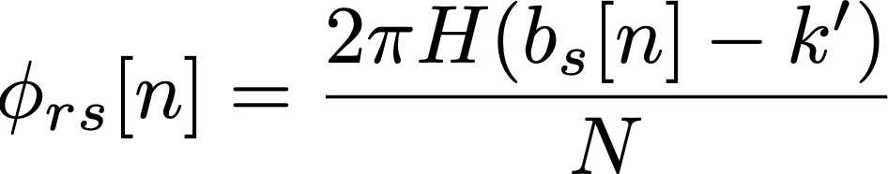
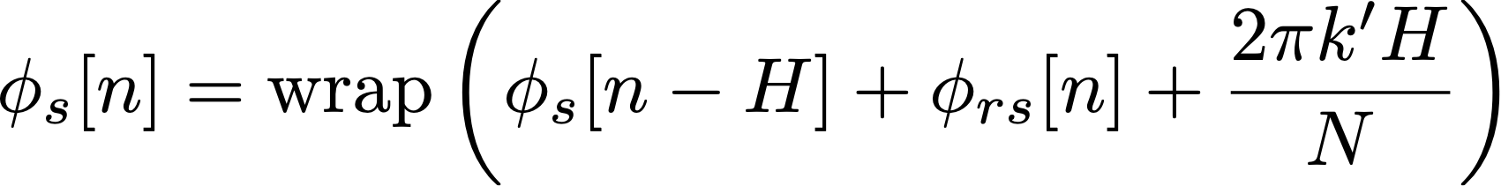
Frequency to phase
Based on the bin frequency, we calculate a phase difference since last hop
Not an absolute phase; we need to remember each bin’s phase from last hop
The process of calculating the bin phase is the reverse of the analysis
The frequency shift gave us a bin k’ and a fractional bin number
Use it to calculate the phase remainder:
How much more or less will the phase advance at the synthesis frequency vs. the bin centre frequency
Then consider the expected phase shift based on the bin centre frequency, and add these to the phase of bin k’ at the last hop
Wrap the phase to be in the ±π range
Meanwhile, the magnitude of the bin doesn’t change in the pitch shift process
ECS7012P Music and Audio Programming • Week 11a

Slide 14


Frequency to phase: code
We are calculating the phase difference from one hop to the next
Therefore, we need a global variable to hold the synthesis phases from the last hop
Since we need to hold a value for each FFT bin, this variable should be an array
Each hop, we add the calculated phase difference to the output phase
Magnitude stays the same
Then we convert back to real and imaginary values, as before:
Real component: Imaginary component:
The functions cosf_neon() and sinf_neon() from the Ne10 library are faster than sin() and cos()
Another efficiency trick: exploit the symmetry of the FFT
We only need to calculate up to (and including) bin N/2
Above this, the bins are conjugate symmetric:
Same real component; negative imaginary component
ECS7012P Music and Audio Programming • Week 11a

Slide 15
Pitch shift task
Task: in the project fft-pitchshift, implement the pitch shifter
The overlap-add process is implemented for you (see Lecture 18 for explanation)
Your code goes in process_fft()
The analysis step (phase to frequency) is already done from Lecture 19
You should implement the synthesis step:
Multiply each frequency component by the pitch shift value:
Check which bin the component belongs in:
Calculate the phase of the new bins:
Convert magnitude and phase to real and imaginary components
To test:
Change pitch shift value in the GUI
If you like, try a real-time audio input using audioRead()
ECS7012P Music and Audio Programming • Week 11a

Slide 16
Pitch shift limitations
Limitations of the pitch shift algorithm
When shifting pitch downward, components which started out in different bins might end up in the same bin (since frequencies get closer together when R < 1)
Artefacts from windowing (e.g. the main lobe and side lobes) will also be shifted
If the original signal has frequency components spaced more closely than the FFT bins, they may not get resolved and shifted correctly
No global preservation of phase which distorts transient events
“Phasiness” is a classic problem with phase vocoder effects
Latency: the longer the FFT, the better the pitch resolution but the longer the latency
There is a big market for high-quality pitch shifting effects
Antares Auto-Tune, introduced in 1997, has become ubiquitous in pop music
Many different pitch shifting guitar pedals on the market
These effects often involve many careful optimisations for sound quality and efficiency
ECS7012P Music and Audio Programming • Week 11a

Slide 17
Revisiting robotisation
Robotisation effect worked by setting all phases to 0 each hop
The fundamental frequency of the effect was fs/H
fs is the sample rate, H is the hop size
For example, fs = 44100, H = 256 yields a base frequency of 172Hz
Limitation 1: H must be an integer
This means the frequency can’t be finely tuned
Limitation 2: H typically doesn’t meet COLA criterion
It’s not an integer division of the FFT size
Non-COLA isn’t big deal since we don’t need exact reconstruction
Limitation 3: can’t do other frequency transformations at the same time
Other phase vocoder effects will assume a more regular hop size
It’s computationally expensive to run two simultaneous overlap-add FFT processes

Slide 18
Revisiting robotisation
How else could we achieve the robotisation effect?
Manipulate the frequency components with the phase vocoder
The pitch shifter used a magnitude-frequency representation of the signal
The hard part was calculating that representation (and getting back again)
The pitch shift itself was simple: multiply by a constant
Let’s use the same magnitude-frequency representation for robotisation
Round each frequency to the nearest integer multiple of the desired fundamental
Keep the magnitudes of each frequency component constant
frequency
component
f
rounded frequency
component
×
round to integer
×
fr
fundamental
frequency
ff
1/x
skip if fr = 0 or fr > fs/2
ECS7012P Music and Audio Programming • Week 11a

Slide 19
Revisiting robotisation: task
Our previous projects expressed frequency in fractional bin numbers
Here, it may be easier to think about actual (discrete time) frequency
In discrete time, frequency ranges from 0 to 2π (corresponding to the sample rate)
We need to rescale our target fundamental frequency by multiplying by 2π/fs
Task: in project fft-robotisation-v2
Round the frequency of each bin to a multiple of the target fundamental
Remember that the rounded frequency might be in a different FFT bin
Keep magnitudes of each frequency component the same
frequency
component
f
rounded frequency
component
×
round to integer
×
fr
fundamental
frequency
ff
1/x
skip if fr = 0 or fr > fs/2

Slide 20
Improving the robotisation effect
You might have heard some artefacts
Frequency components glide smoothly up and down in the original signal
Now, they jump from one harmonic to another
The result is a trill-like effect
Alternative approach: interpolation
For each frequency component, generate energy at harmonics above and below
Scale the magnitude of the upper and lower harmonics depending on which harmonic is closer to the original frequency
This is a form of linear interpolation (see Lecture 3 for more)
Task: in fft-robotisation-v2, implement linear interpolation
Create two synthesis frequencies for each analysis frequency
Will often need to mix multiple components together in one FFT bin
rounded
original
frequency
fundamental
time

Slide 21
Phase vocoder: more ideas
Ways to improve the quality of the effects:
When mixing components into an FFT bin, use RMS amplitude rather than linear addition
When mixing components into an FFT bin, find the weighted average of the frequencies
Implement peak tracking to reduce some of the effects of window lobes
Other effects using the phase vocoder:
Combine a frequency detector with a pitch shift to implement auto-tuning
Cross-synthesis: combine frequencies from one signal with magnitudes from another
Noise reduction: suppress frequency components below a threshold or matching a known profile
As the effects become more complex, CPU becomes a limitation
Try larger hop sizes (which may also require larger FFTs)
Pre-calculate frequently used constants (e.g. bin frequencies)
Look for other optimisations to reduce the number of multiplies per hop
The Bela NEON library (math_neon) contains optimised versions of common functions

